Slide 1


Slide 2
The Wood Innovation Cluster, established in 2018, unites key stakeholders in the wood industry, collaboratively fostering regional growth and development.
A regional reinforcement that creates value
Notes:
Inget manus läser i slice

Slide 3





The Wood Innovation Cluster
– a regional reinforcement that creates value
Skellefteå municipality coordinates the Wood Innovation Cluster, connecting companies with research, development, education, testing activities, and promoting sustainable procurement.
The municipalitys operational activities in sustainable wood construction aim to foster robust development and knowledge sharing in colla-boration with local, national,
and international stakeholders.
We take responsibility for advancing wood construction and highlighting the opportunities wood offers for climate-smart building.
Britt-Inger Brisadotter is the Manager of the Wood Innovation Cluster in Skellefteå municipality
Träbransch Norr is a development company and it is ownd by SME-Träföretaget in Västebotten.
Träbransch Norr's mission is to drive business development and innovation for timber companies from raw material to finished product. The focus is on fostering collaboration among timber companies, enhancing wood processing, developing products that strengthen competitiveness, support sustainability initia-tives, and contribute to circular practices for both businesses and society at large.
Lena Drugge is Managing Director.
Stiftelsen Träenigheten is a foundation Founded in 1995, With the purpose of supporting research, development, and education at Skellefteå Campus, they will collectively promote innovations, leveraging new thinking to achieve increased growth in the region's wood sector.
Dan Magnusson is the Chairman.
RISE is Sweden'sresearch instituteand innovation partner. The Wood Construction unit is based in Skellefteå, and drives the development of climate-smart and sustainable constructionin Sweden and internationally.
Karin Sandberg is senior researcher.
At the Department of Wood Technology at Luleå University of Technology, we align our efforts with the needs of the wood mechanical industry. Our research and education span the entire wood value chain, from the finished wood product back to the forest. Wood Technology at Luleå University of Tech-nology in Skellefteå serves as Sweden's hub for wood tech-nology research and education.
Professor Dick Sandberg
leads the Wood Technology department within the Department of Engineering Sciences and Mathematics.
TräCentrum Norr is a center within Luleå University of Technology dedicated to optimizing the wood value chain from forest to finished product through applied research and innovation. Our mission is to achieve sustaina-bility in the most effective manner possible. TräCentrum Norr's activities focus on fostering collaboration be-tween industry and academia to generate knowledge, products, and services that enhance sustainability, strengthen competitiveness, and prioritize circularity.
Bror Sundqvist is Managing Director.
www.skelleftea.se/trainnovation/trainnovationsklustret
https://www.linkedin.com/company/90827040/admin/feed/posts
Notes:
The Wood Innovation Cluster is the spearhead that brings together our historical knowledge for today's high-tech expertise in the wood industry. Here is a width of companies, outstanding wood technology research, future education, and advanced testing activities. Together we show how wood can be transformed in different innovative ways and encourage the public to become better customers.
Here you see the overall matrix of us actors - We have clear roles and work together to promote wooden construction-
We have our own budgets for respective organisation - And if necessary support each other with co-financing for the operational.
Skellefteå kommun samordnar Träinnovationsklustret i Skellefteå som knyter ihop företag med forskning, utveckling, utbildning, provningsverksamhet och sporrar det offentliga att bli en bättre beställare.

Slide 4
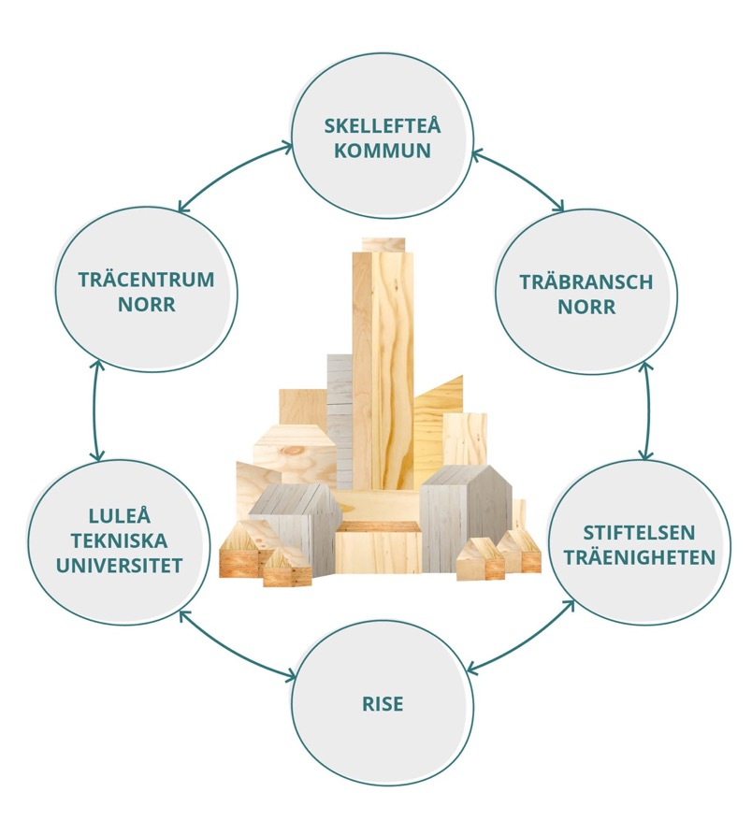



The Wood Innovation Cluster
– a regional reinforcement that
creates value
This is how we work
This is how it all comes together
This is how we create value
COOPERATION PARTNERS:
Notes:
The Wood Innovation Cluster is the spearhead that brings together our historical knowledge for today's high-tech expertise in the wood industry. Here is a width of companies, outstanding wood technology research, future education, and advanced testing activities. Together we show how wood can be transformed in different innovative ways and encourage the public to become better customers.
Skellefteå kommun samordnar Träinnovationsklustret i Skellefteå som knyter ihop företag med forskning, utveckling, utbildning, provningsverksamhet och sporrar det offentliga att bli en bättre beställare. I Skellefteåregionen främjas utvecklingen av trä i byggandet genom att involvera forsknings- och innovationsaktiviteter i byggprojekt. Där kan förbättrad teknik och nya innovationer tillämpas samt skapas ny kunskap för framtida byggnationer.

